Slide 1

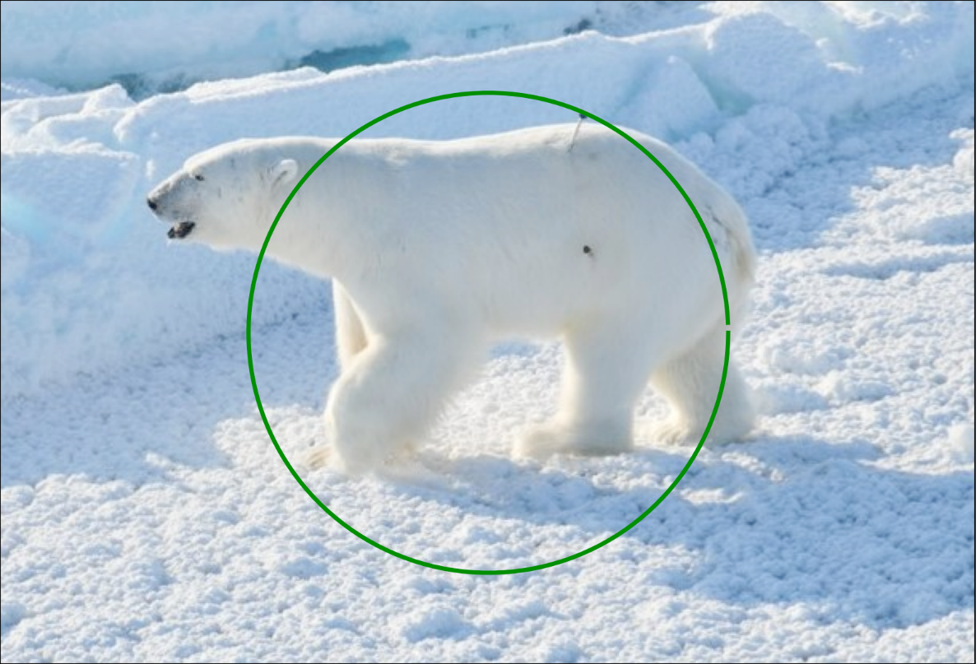
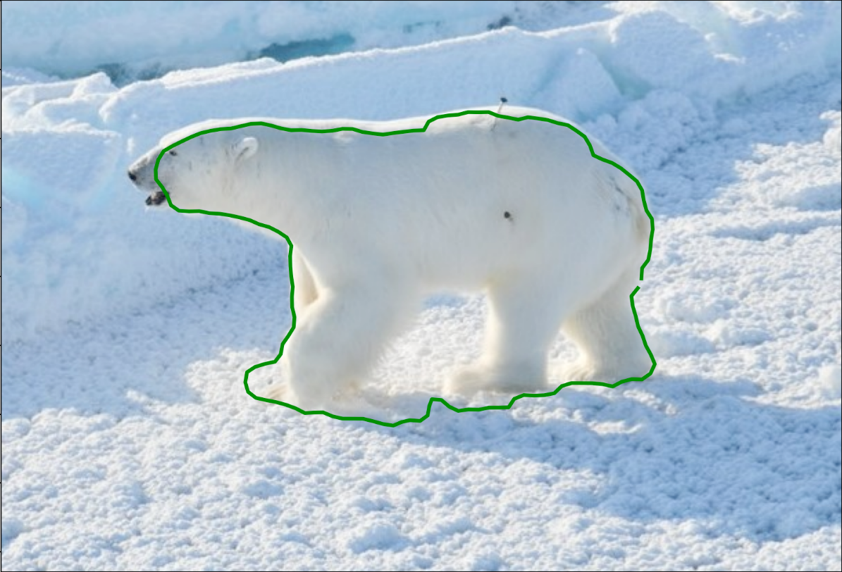
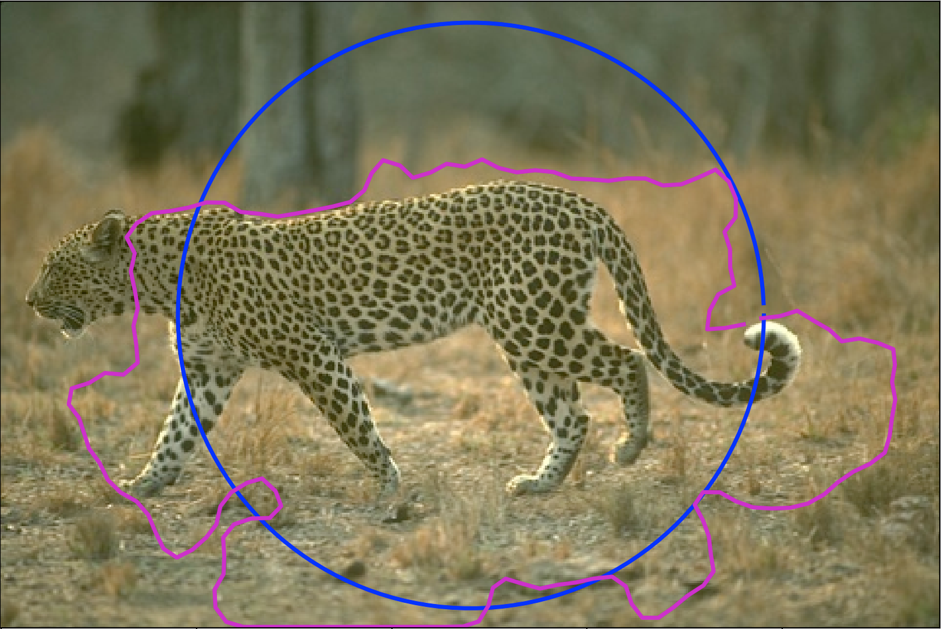
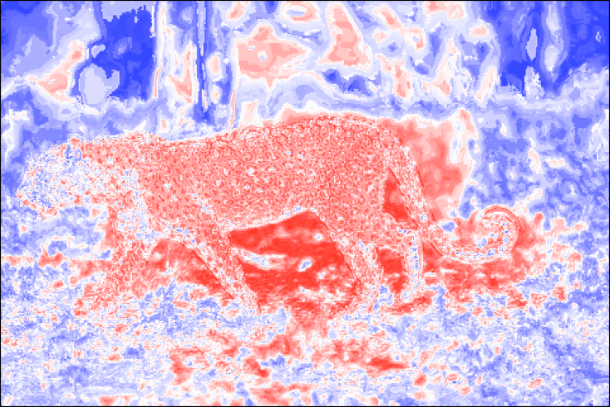
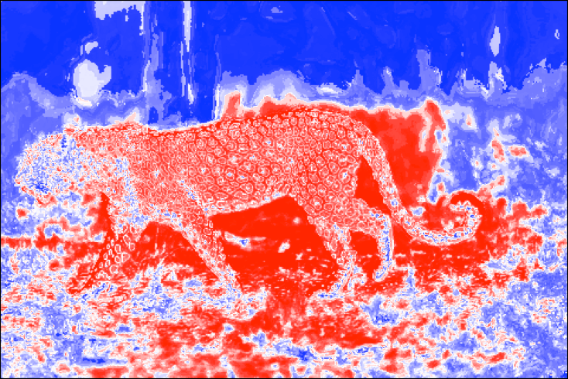
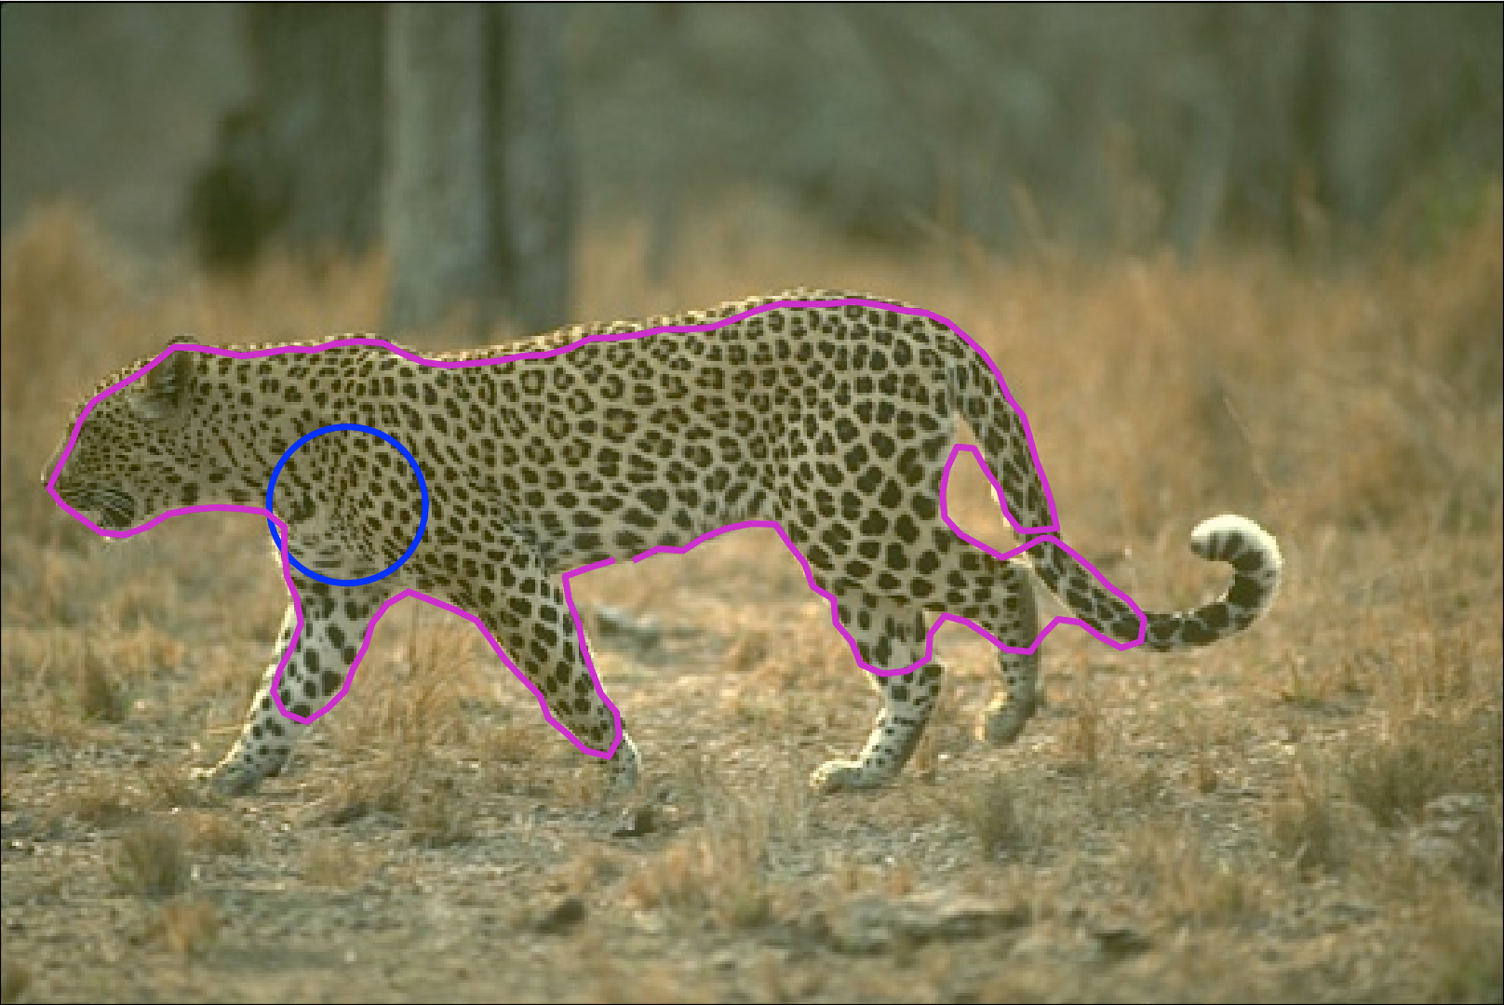
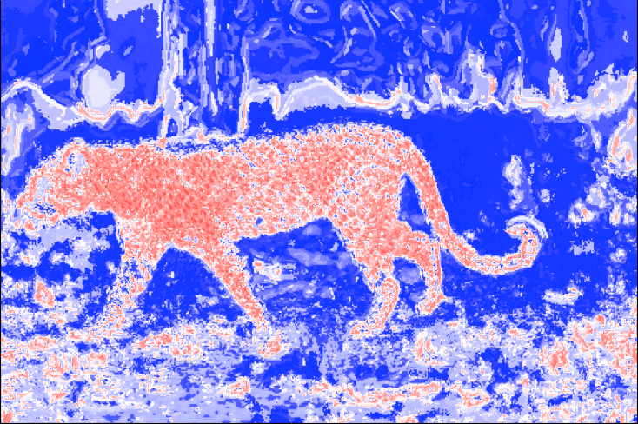
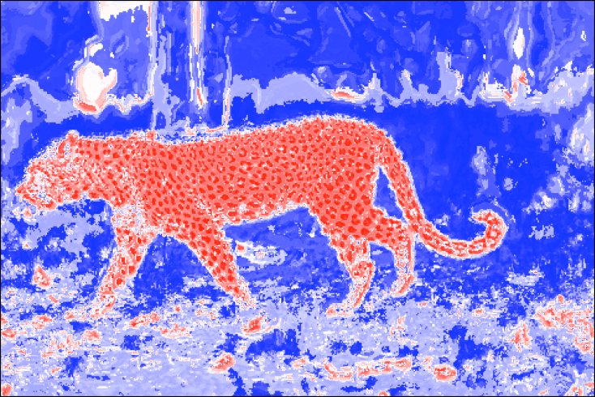
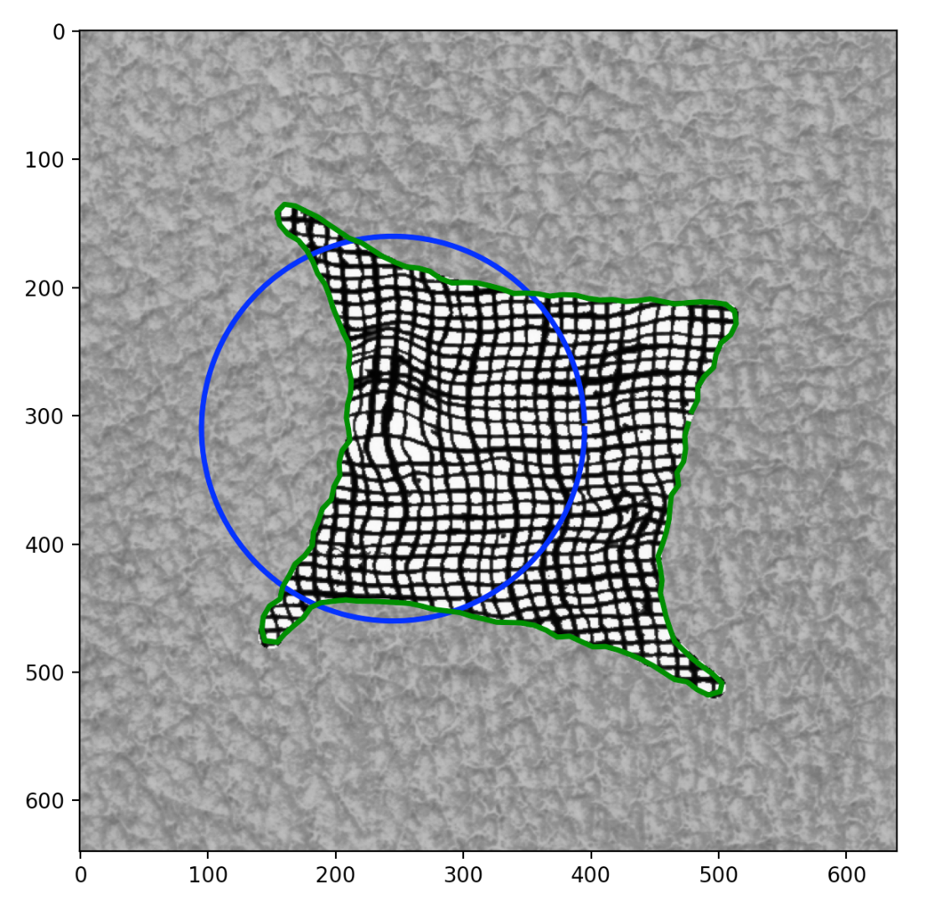
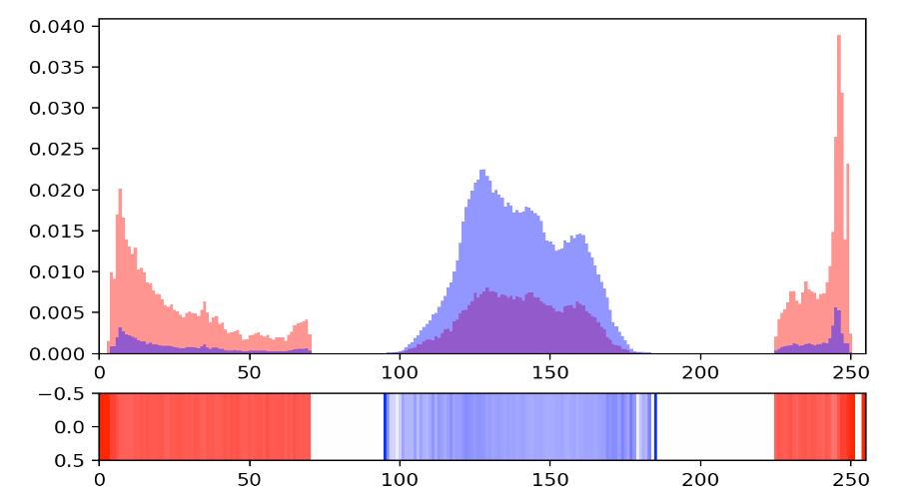
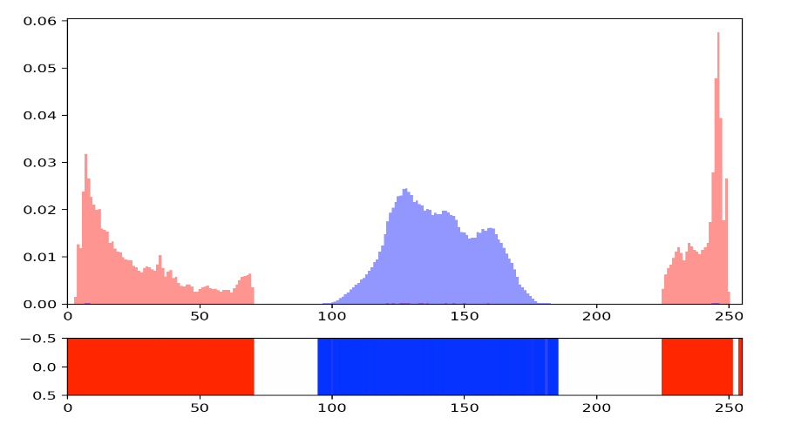
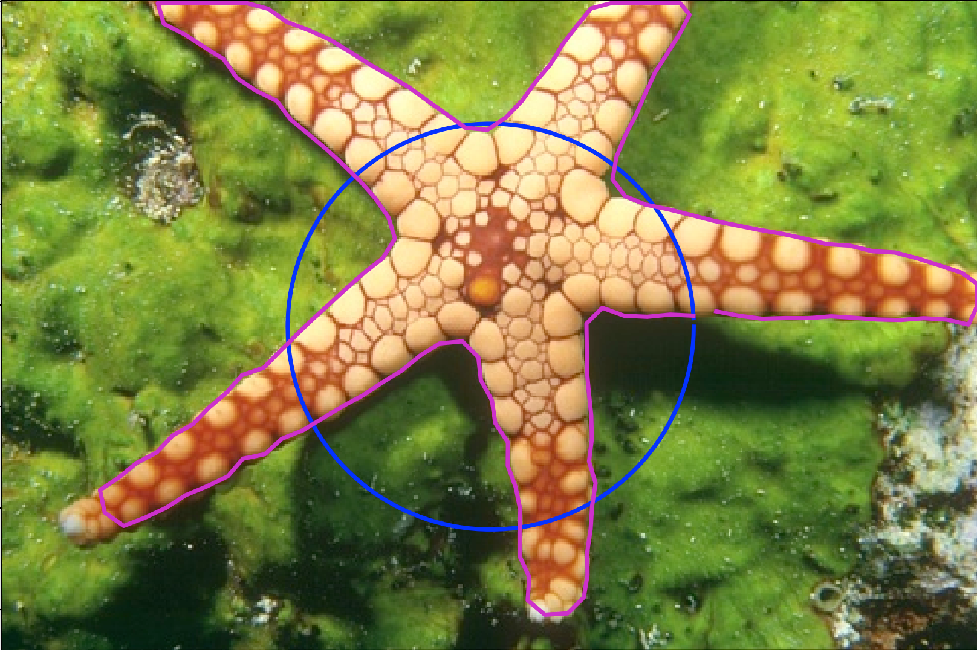
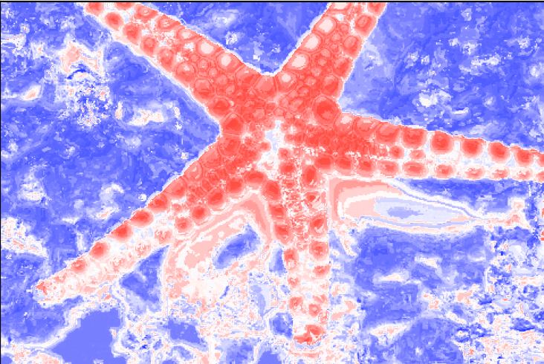
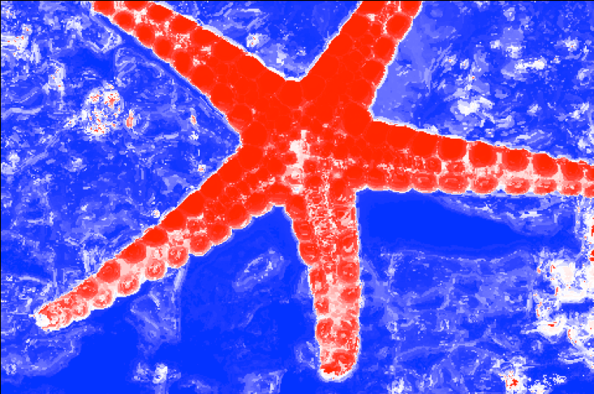
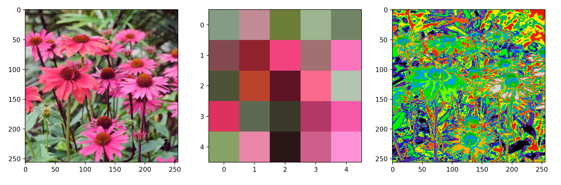
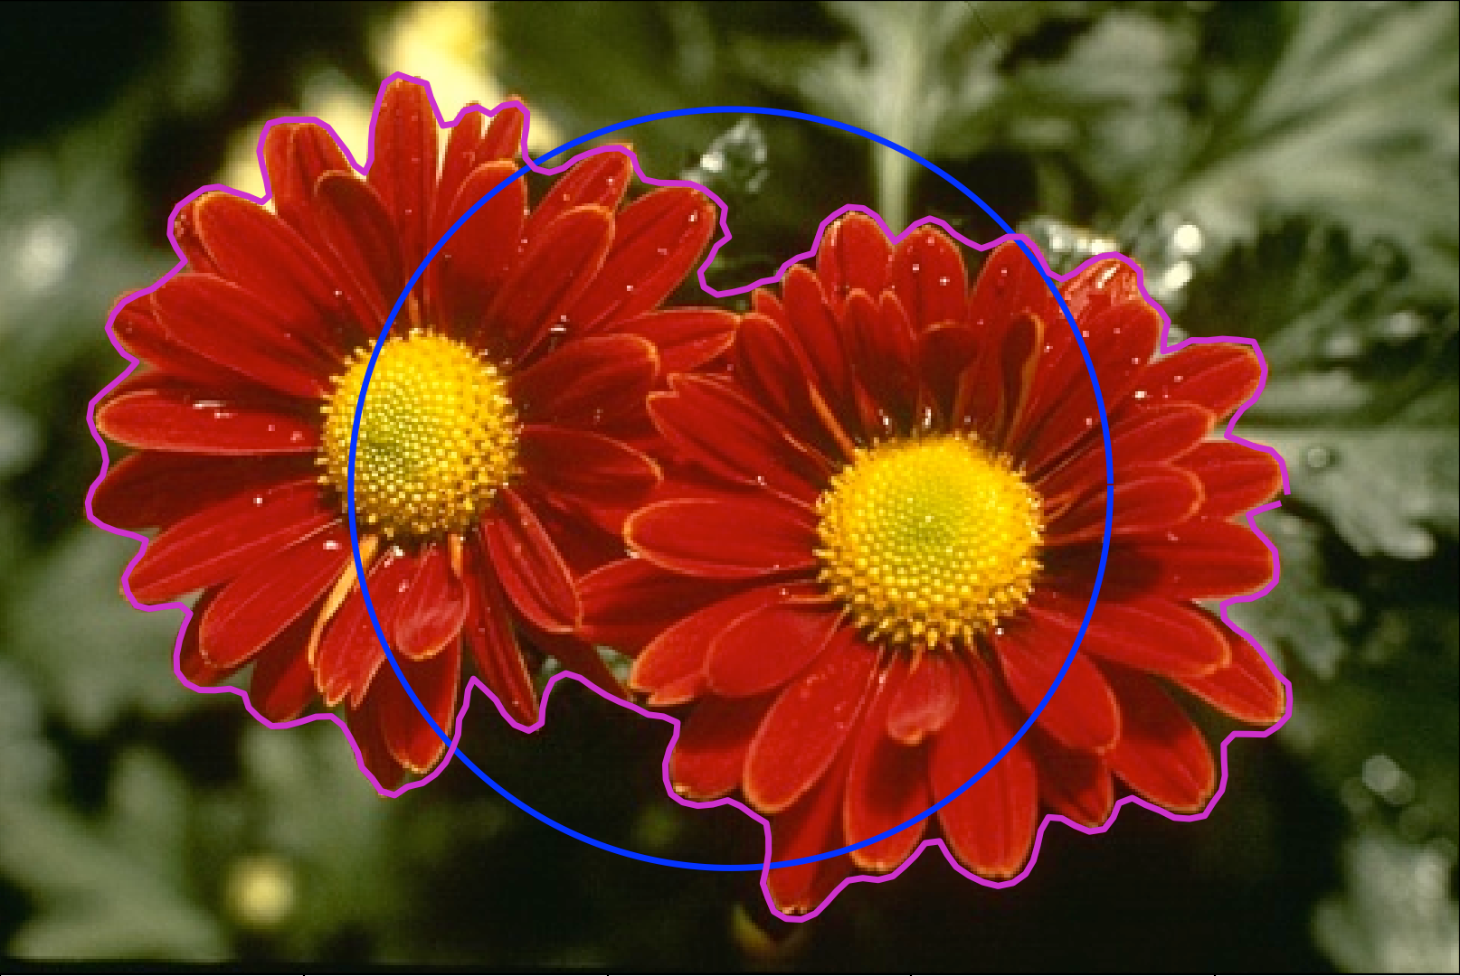
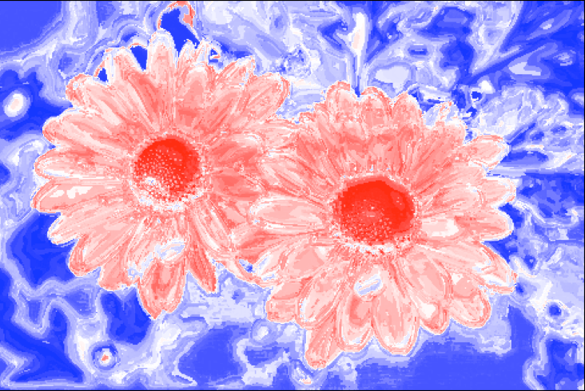
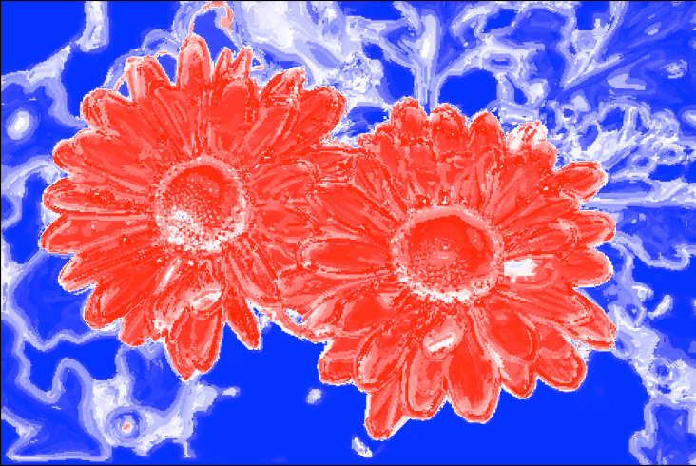
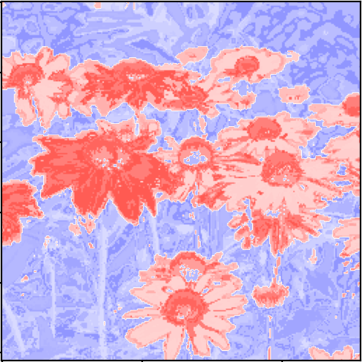
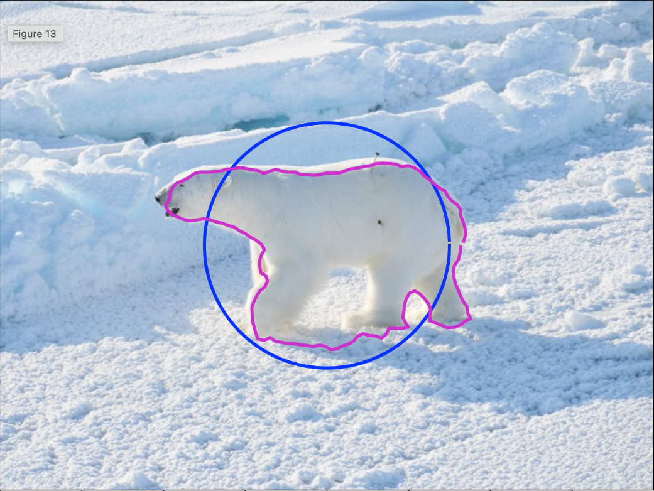
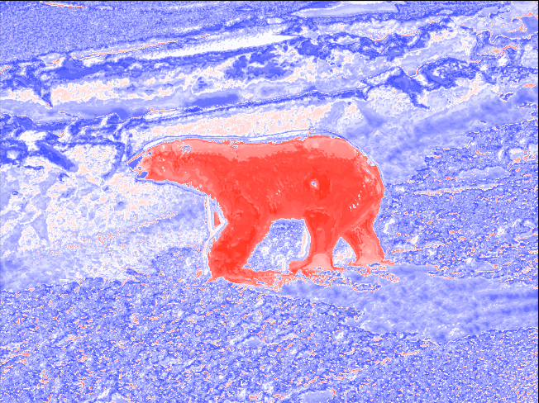
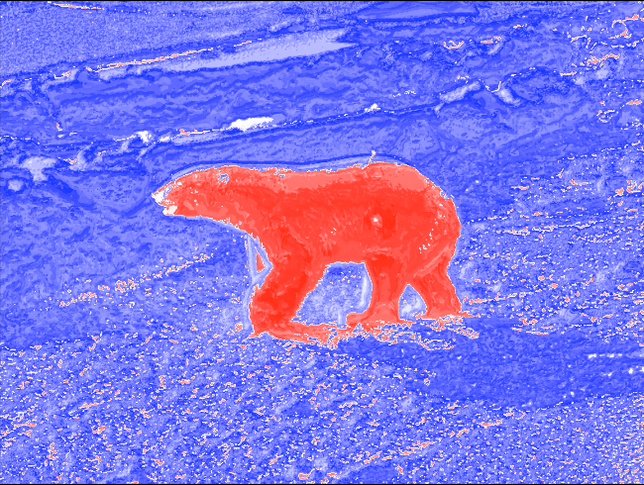
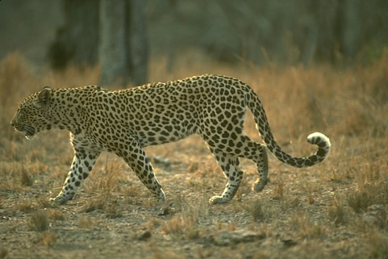
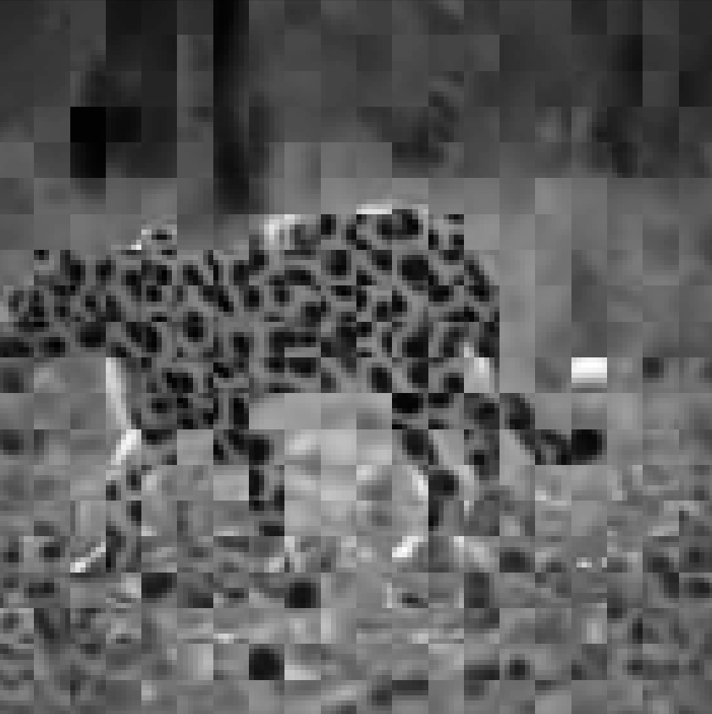
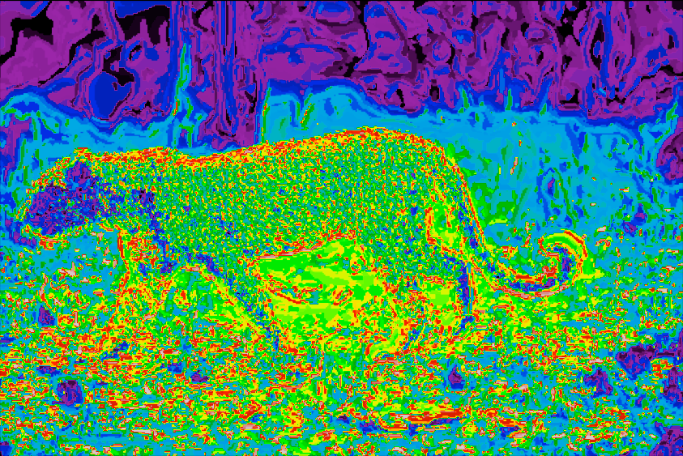
Finding a Polar Bear on Ice - Using Probabilistic Chan-Vese
02506 Advanced Image Analysis
Poster Session 03/05/2022
By: J. Hammer Hedeman and G. Leth-Espensen
Introduction
Steps in the algorithm?
The purpose of this project is to separate an image in foreground and background using probabilistic Chan-Vese.
Initialize snake.
2. Create color and texture dictionary.
3. Create inside and outside histograms.
4. Calculate probabilities from the snake points.
5. Calculate and apply forces to snake.
6. Repeat step 3 – 5 until convergence condition is met.
Initial Conditions
Initial condition had profound effect on the results. However, even bad initial conditions gave useful results.
From left to right: Initial snake (blue) / final snake (magenta), Initial probability map, and final probability map (red = pin).
Theory
Probabilistic Chan-Vese works by looking at a pixel in the image and calculating the probability of that pixel being either foreground or background. The probability destribution is based on the histograms of the inside and outside of an boundery shape called a snake. The histograms in the project are made from a combination of three different parameters weighted dependant on picture. The parameters are intensity based, color based and texture based.
Intensity based
Uses the pixel intensities in grayscale, then creates traditional image histograms. This works well when there is a high contrast between values of the foreground and background.
Results?
These are some of the results based on best weight between parameters.
Color based
Creates a dictionary of colors in the image using K-means clustering. This extracts the most defining colors of the image. Each pixel in the image is then assigned to a cluster. This assignment is then used for the probability histogram.
Texture based
Creates a dictionary of textures by using K-means clustering on patches of the image. Each pixel is then assigned to a patch based on the area around the pixel. This is then used for the probability histogram.
Future improvements
Being able to work with multiple areas as foreground.
Minimize influence of initial conditions, such as the placement and size of the initial snake. This could be done by initialising several snakes in different position, making a probability map from each result, and use this to find the foreground.
Notes:
Tekst og Streger i 100% farve – Baggrund i 90% Transparent.

